Slide 1

Spring Boot
Sam Merchant

Slide 2
Spring Boot Introduction
Spring Initializr
  https://start.spring.io/
Rest Service
  https://spring.io/guides/gs/rest-service/
Spring Boot Dev Tools
  https://docs.spring.io/spring-boot/docs/current/reference/html/using-boot-devtools.html

Slide 3
@SpringBootApplication
@SpringBootApplication annotation can be used to enable those three features,
  @EnableAutoConfiguration: enable Spring Boot’s auto-configuration mechanism
  @ComponentScan: enable @Component scan on the package where the application is located
  @Configuration: allow to register extra beans in the context or import additional configuration classes
Notes:
@Configuration Indicates that a class declares one or more @Bean methods and may be processed by the Spring container to generate bean definitions and service requests for those beans at runtime
@Component Indicates that an annotated class is a "component". Such classes are considered as candidates for auto-detection when using annotation-based configuration and classpath scanning.
@Configuration is meta-annotated with @Component, therefore @Configuration classes are candidates for component scanning

Slide 4
Spring Caching
<artifactId>spring-boot-starter-cache</artifactId>
@Cacheable("CacheName")
@EnableCaching
Default Cache Manager : concurrent maps in memory
https://docs.spring.io/spring-boot/docs/current/reference/html/boot-features-caching.html
Notes:
The @EnableCaching annotation triggers a post processor that inspects every Spring bean for the presence of caching annotations on public methods. If such an annotation is found, a proxy is automatically created to intercept the method call and handle the caching behavior accordingly.
The annotations that are managed by this post processor are Cacheable, CachePut and CacheEvict. You can refer to the javadocs and the documentation for more details.

Slide 5
Spring Schedule Task
<artifactId>spring-boot-starter</artifactId>
@Scheduled(fixedRate = 5000)
@Scheduled(fixedDelay = 5000)
@Scheduled(cron="0 * * * * *")
@EnableScheduling
https://spring.io/guides/gs/scheduling-tasks/
Notes:
The @EnableCaching annotation triggers a post processor that inspects every Spring bean for the presence of caching annotations on public methods. If such an annotation is found, a proxy is automatically created to intercept the method call and handle the caching behavior accordingly.
The annotations that are managed by this post processor are Cacheable, CachePut and CacheEvict. You can refer to the javadocs and the documentation for more details.

Slide 6
Spring Async
<artifactId>spring-boot-starter</artifactId>
@Async has two limitations
  it must be applied to public methods only
  self-invocation – calling the async method from within the same class – won’t work
Methods with void Return Type
Methods With Return Type
Default Task Executor : SimpleAsyncTaskExecutor
@EnableAsync

Slide 7
Spring Cloud
Service registration and discovery
Routing
Service-to-service calls
Load balancing
Circuit Breakers
https://spring.io/projects/spring-cloud

Slide 8
Spring Cloud Actuator
Dependency :
<artifactId>spring-boot-starter-actuator</artifactId>
Enable Actuators
management.endpoints.web.exposure.include=*
View Actuators:
http://localhost:8090/actuator/

Slide 9
Spring Cloud Config
Dependency : Spring Boot Actuator and Spring Config Client
@EnableAutoConfiguration
Dependency : Spring-cloud-config-server
@EnableConfigServer
Runs on Port : http://localhost:8888
https://spring.io/projects/spring-cloud-config

Slide 10
HYSTRIX
Circuit Breaker
<artifactId>spring-cloud-starter-netflix-hystrix</artifactId>
@EnableCircuitBreaker
@HystrixCommand(fallbackMethod = "reliable")
https://spring.io/guides/gs/circuit-breaker/
https://cloud.spring.io/spring-cloud-netflix/multi/multi__circuit_breaker_hystrix_dashboard.html

Slide 11
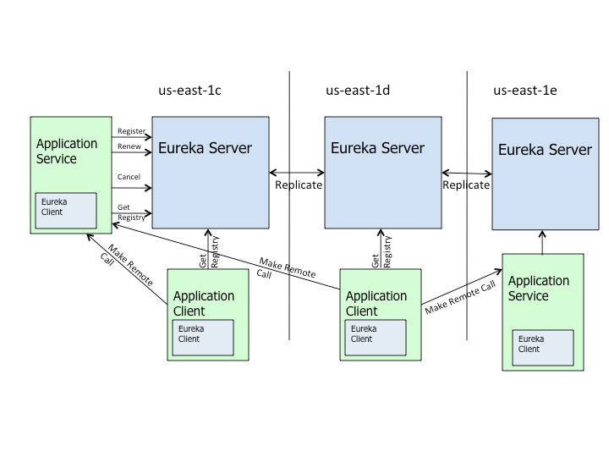
EUREKA
Eureka Server
Eureka Client
https://spring.io/guides/gs/service-registration-and-discovery/

Slide 12
Feign
Feign aims at simplifying HTTP API clients
Declarative Client
https://www.baeldung.com/intro-to-feign
https://cloud.spring.io/spring-cloud-netflix/multi/multi_spring-cloud-feign.html

Slide 13
Zepkins/Spring Cloud Sluth
Borrowing heavily from Dapper, Zipkin and Htrace
Distributed Tracing

